Slide 1
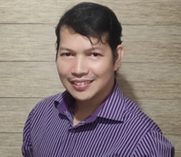



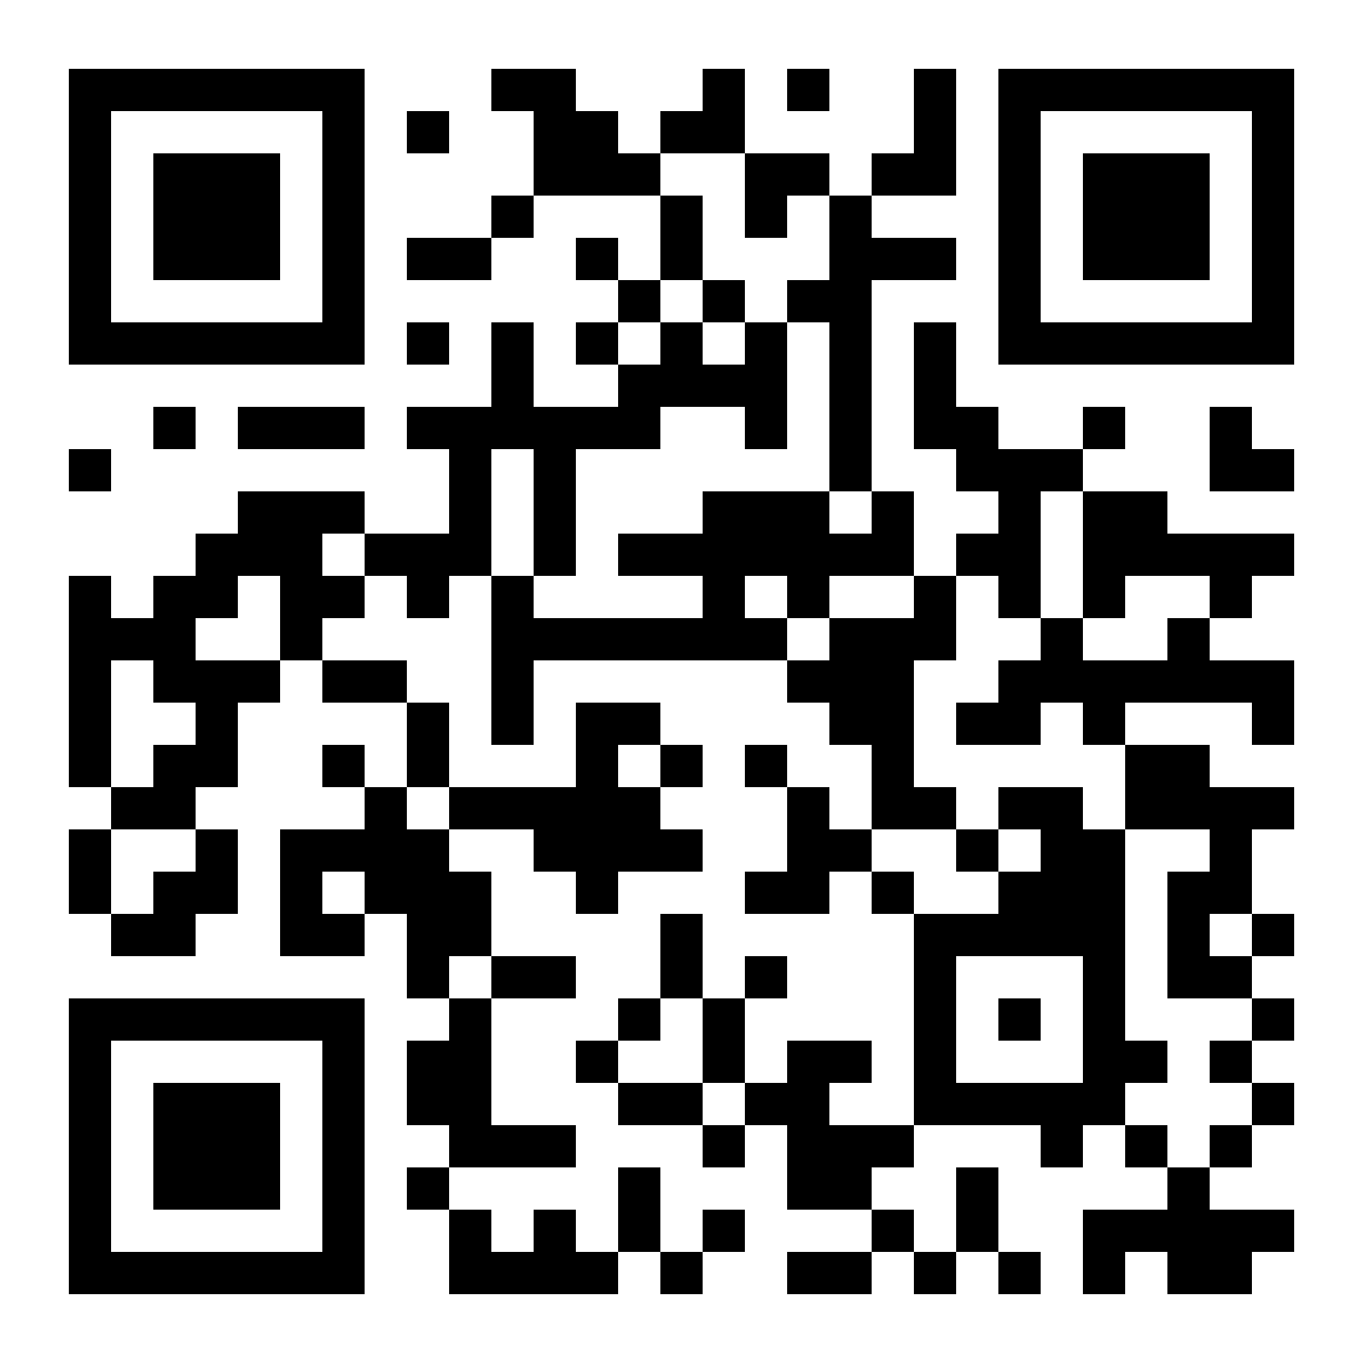




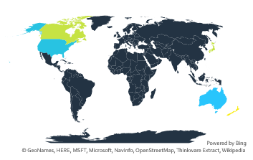
Infographic Resume
Solomio Sisante
Full Stack Developer
Email:
solomiosisante@gmail.com
Skype
sol.sisante
Phone
+639772953375
LinkedIn
linkedin.com/in/solomiosisante
Expertise
Professional Goal is to Learn, Share and Deliver
30
Years
IT
22 .Net years.
10 years as a Sr. Dev
5 years as Lead Dev
2009-Went to Auckland, New Zealand to share knowledge
Short Bio
Code IDEs and DB Management Tools
I began my journey as a Dbase 3+ developer in 1994. In 2002, I received training in .Net from Microsoft-certified professionals, and by 2005, I was leading teams.
I have a passion for simplifying applications by implementing proper documentation, testing, and automation.
Lives in Bacoor City, Philippines
Vercel
SSMS
VS Code
Visual Studio
PERSONAL
Education
Remote Projects
On Sundays, I dedicate my time to God and family. I also love playing the guitar, singing my lungs out, and have even composed a few songs.
1990-1991
Mapua Institute of Technology (MIT)
BS Electrical Engineering
1993-1994
Technological Institute of the Philippines Computer Technology
2002
AMA Computer Learning Center
Computer Science.
+5
+50
+100
None

